Slide 2
Divide & Conquer Algorithms

Slide 3
Motivation
Given a large data set
Divide: This involves dividing the problem into some sub problem.
Conquer: Sub problem by calling recursively until sub problem solved.
Combine: The Sub problem Solved so that we will get find problem solution.

Slide 4
What did we do?
We are breaking down a larger problem into smaller sets (DIVIDE).
After solving the smaller set problems (CONQUER), we combine the answers.

Slide 5
General Template
Divide_and_Conquer (x)
if x is small or simple
return solve(x)
else
Decompose x into smaller sets x₀, x₁, … x_{n}
for (i=0; i<n; i++)
y_{i} = Divide_and_Conquer(x_{i})
Recombine y_{i}’s (We have solved y for x)
return y

Slide 6
Three Conditions that make D&C worthwhile
It must be possible to decompose an instance into sub-instances.
It must be efficient to recombine the results.
Sub-instances should be about the same size.

Slide 7
Binary Search
In each step, the algorithm compares the input element x with the value of the middle element in array.
If the values match, return the index of the middle.
Otherwise, if x is less than the middle element, then the algorithm recurs for left side of middle element.
else recurs for the right side of the middle element.

Slide 8
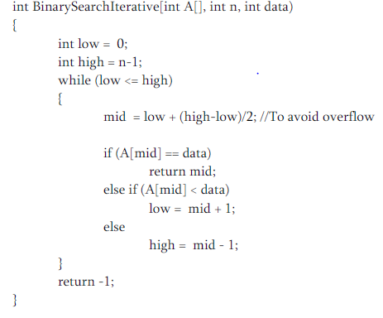
Iterative Binary Search Algorithm

Slide 9
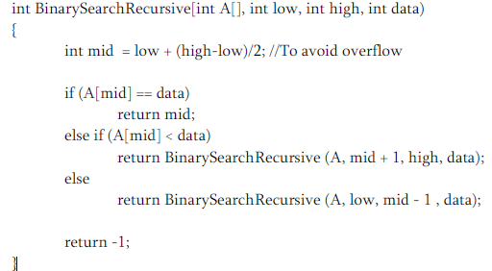
Recursive Binary Search Algorithm

Slide 10
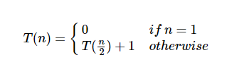
Analysis
Recurrence for binary search is
Using this recurrence relation T(n)= logn
Therefore, binary search uses O(logn) time.
In case of recurrence space complexity is also O(logn)

Slide 11
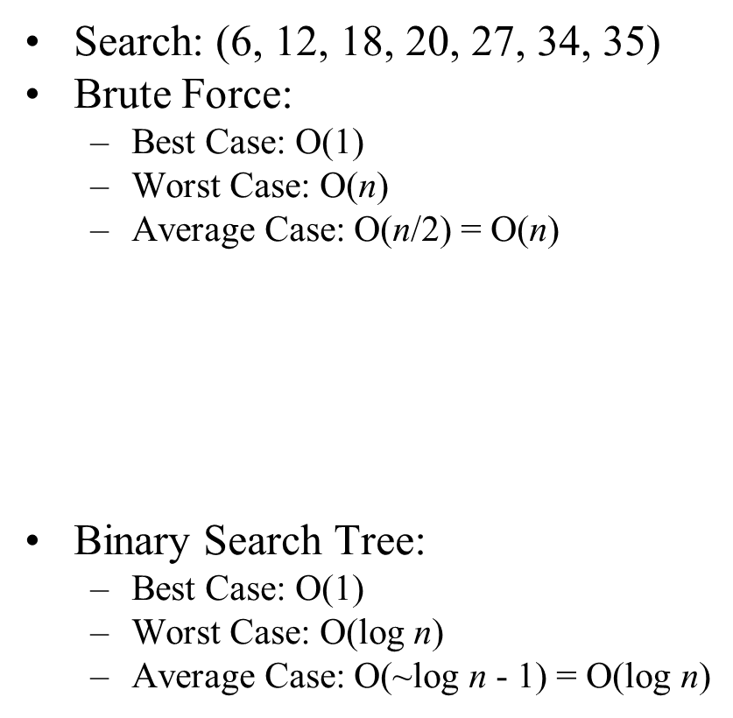
Example
20
12
34
6
18
27
35

Slide 12
QuickSort
It picks an element as pivot and partitions the given array around the picked pivot.
There are many different versions of quickSort that pick pivot in different ways.
Always pick first element as pivot.
Always pick last element as pivot.
Pick a random element as pivot.
Pick median as pivot.

Slide 13
QuickSort
The key process in quickSort is partition()
Target of partitions is, given an array and an element x of array as pivot.
put x at its correct position in sorted array and put all smaller elements (smaller than x) before x.
put all greater elements (greater than x) after x.

Slide 14
Algorithm
quickSort(arr[], low, high)
{
if (low < high)
{
pi = partition(arr, low, high);
quickSort(arr, low, pi - 1); // Before pi
quickSort(arr, pi + 1, high); // After pi
}
}

Slide 15
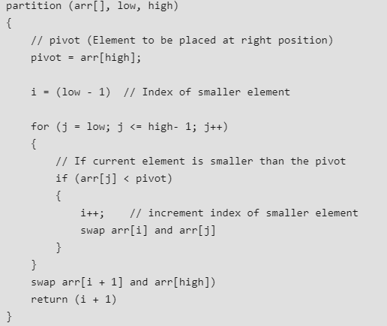
Continue…

Slide 16
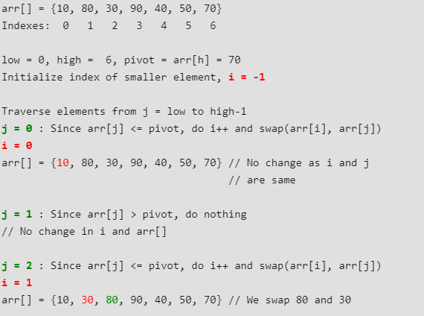
Example

Slide 17
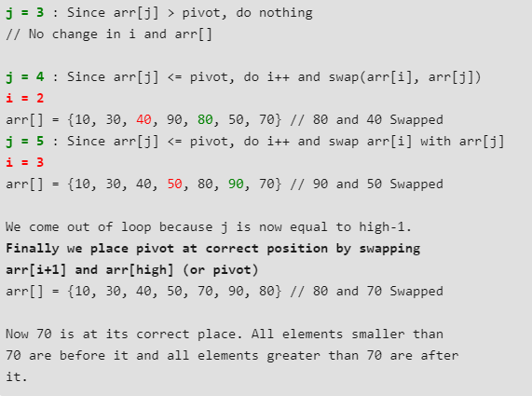
Continue…

Slide 18
Analysis
Worst Case: when we have sorted array.
For example A [1,2,3,4,5,6]
T(n)= O(n)+ T(n-1)
= O(n^2)
Basically Partition algorithm is majorly taking the time in Quicksort.
In case of sorted input partition algorithm have to run for ‘N’ time so we can say that
n*(Time taken by partition algorithm)
n*O(n)=O(n^2)

Slide 19
Analysis
Best case: When partition element always breaks the array into two equal sub arrays.
T(n)=O(n)+2T(n/2)
Average Case: Let us assume partition element breaks array into 1:9 form.
T(n)=O(n)+T(n/10)+T(9n/10)

Slide 20
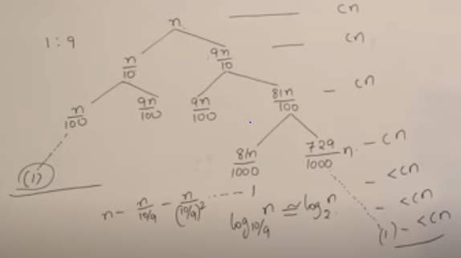
Analysis
So the complexity will be Θ(nlogn)

Slide 21
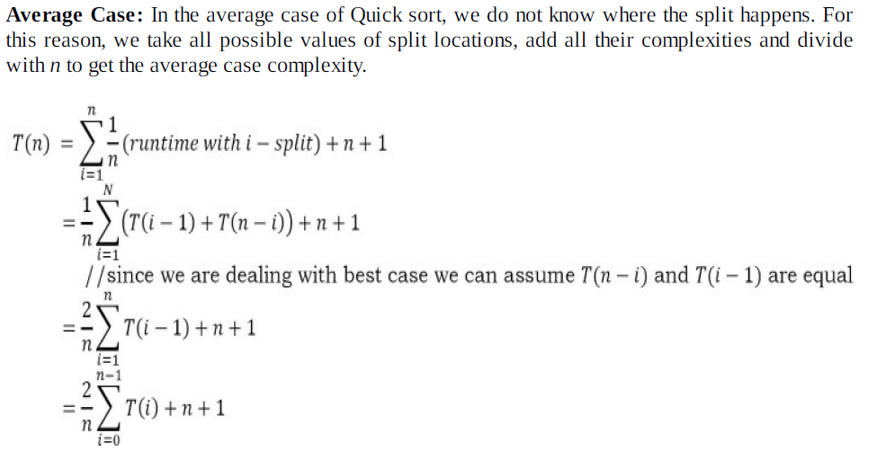

Slide 22
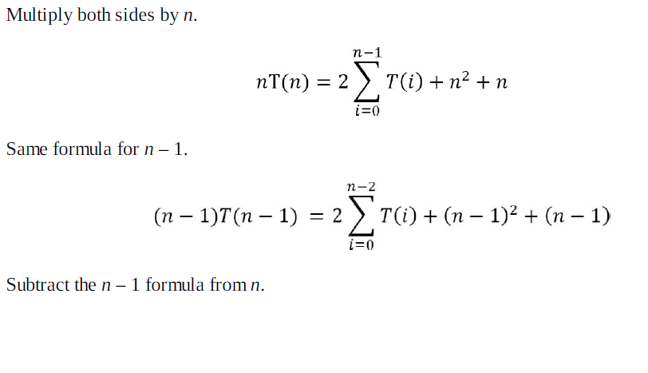

Slide 23
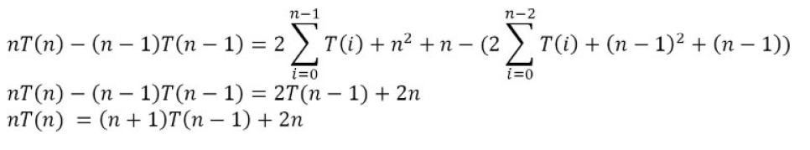

Slide 24
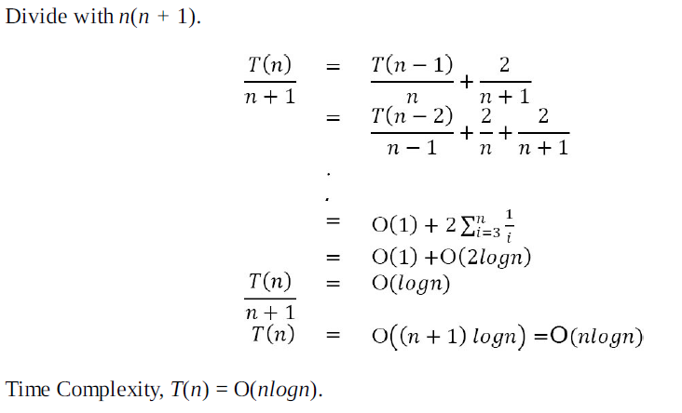

Slide 25
Merge sort
Merge Sort is a Divide and Conquer algorithm.
It first divides an array into smaller subarrays and then merges them together to get a sorted array.
The merge() function is used for merging two halves.

Slide 26
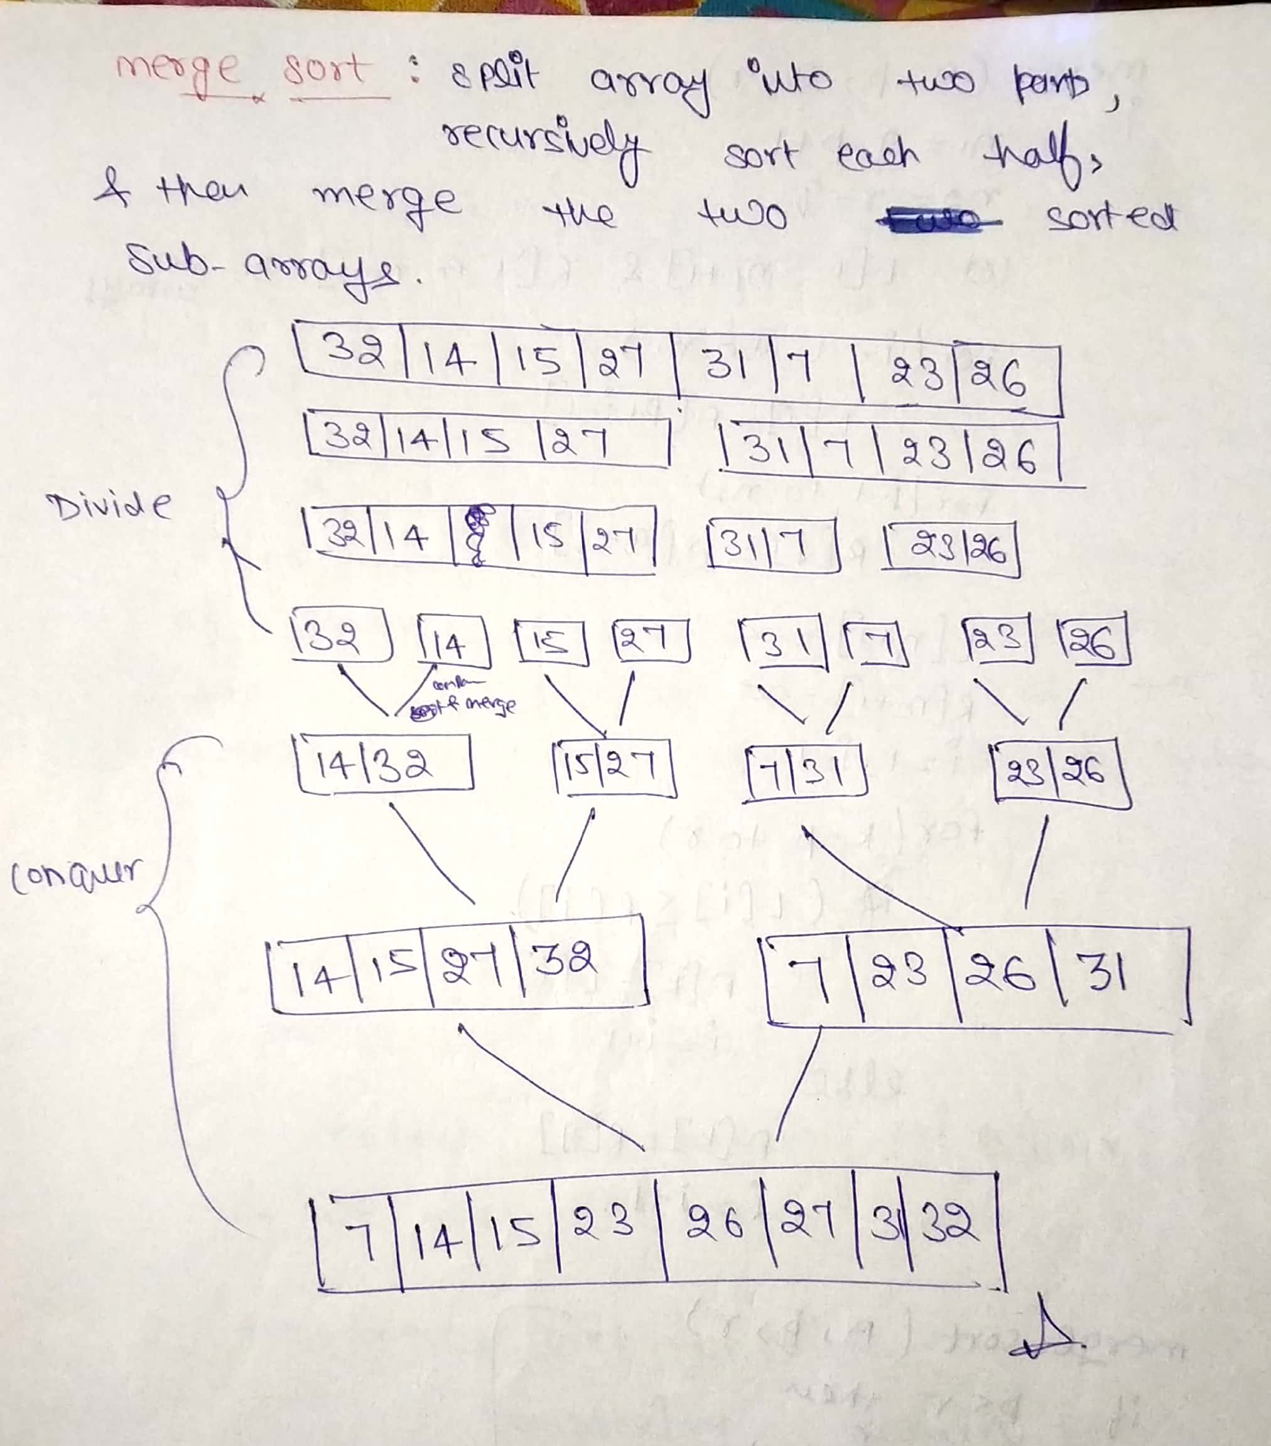

Slide 27
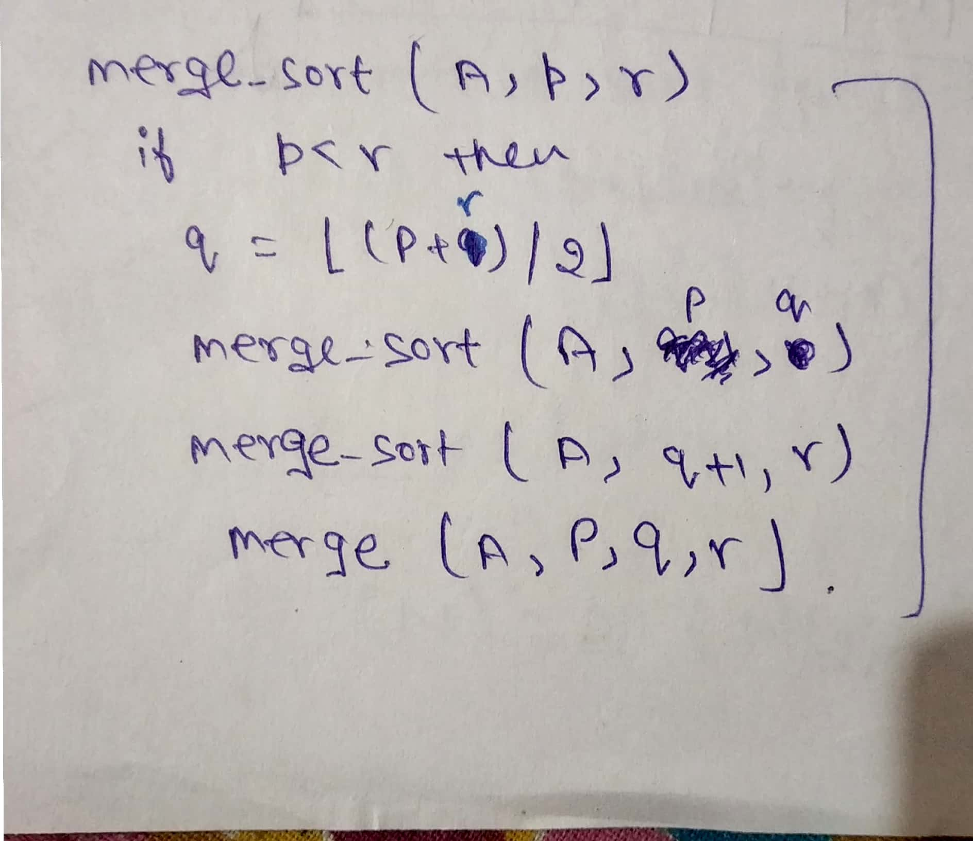

Slide 28
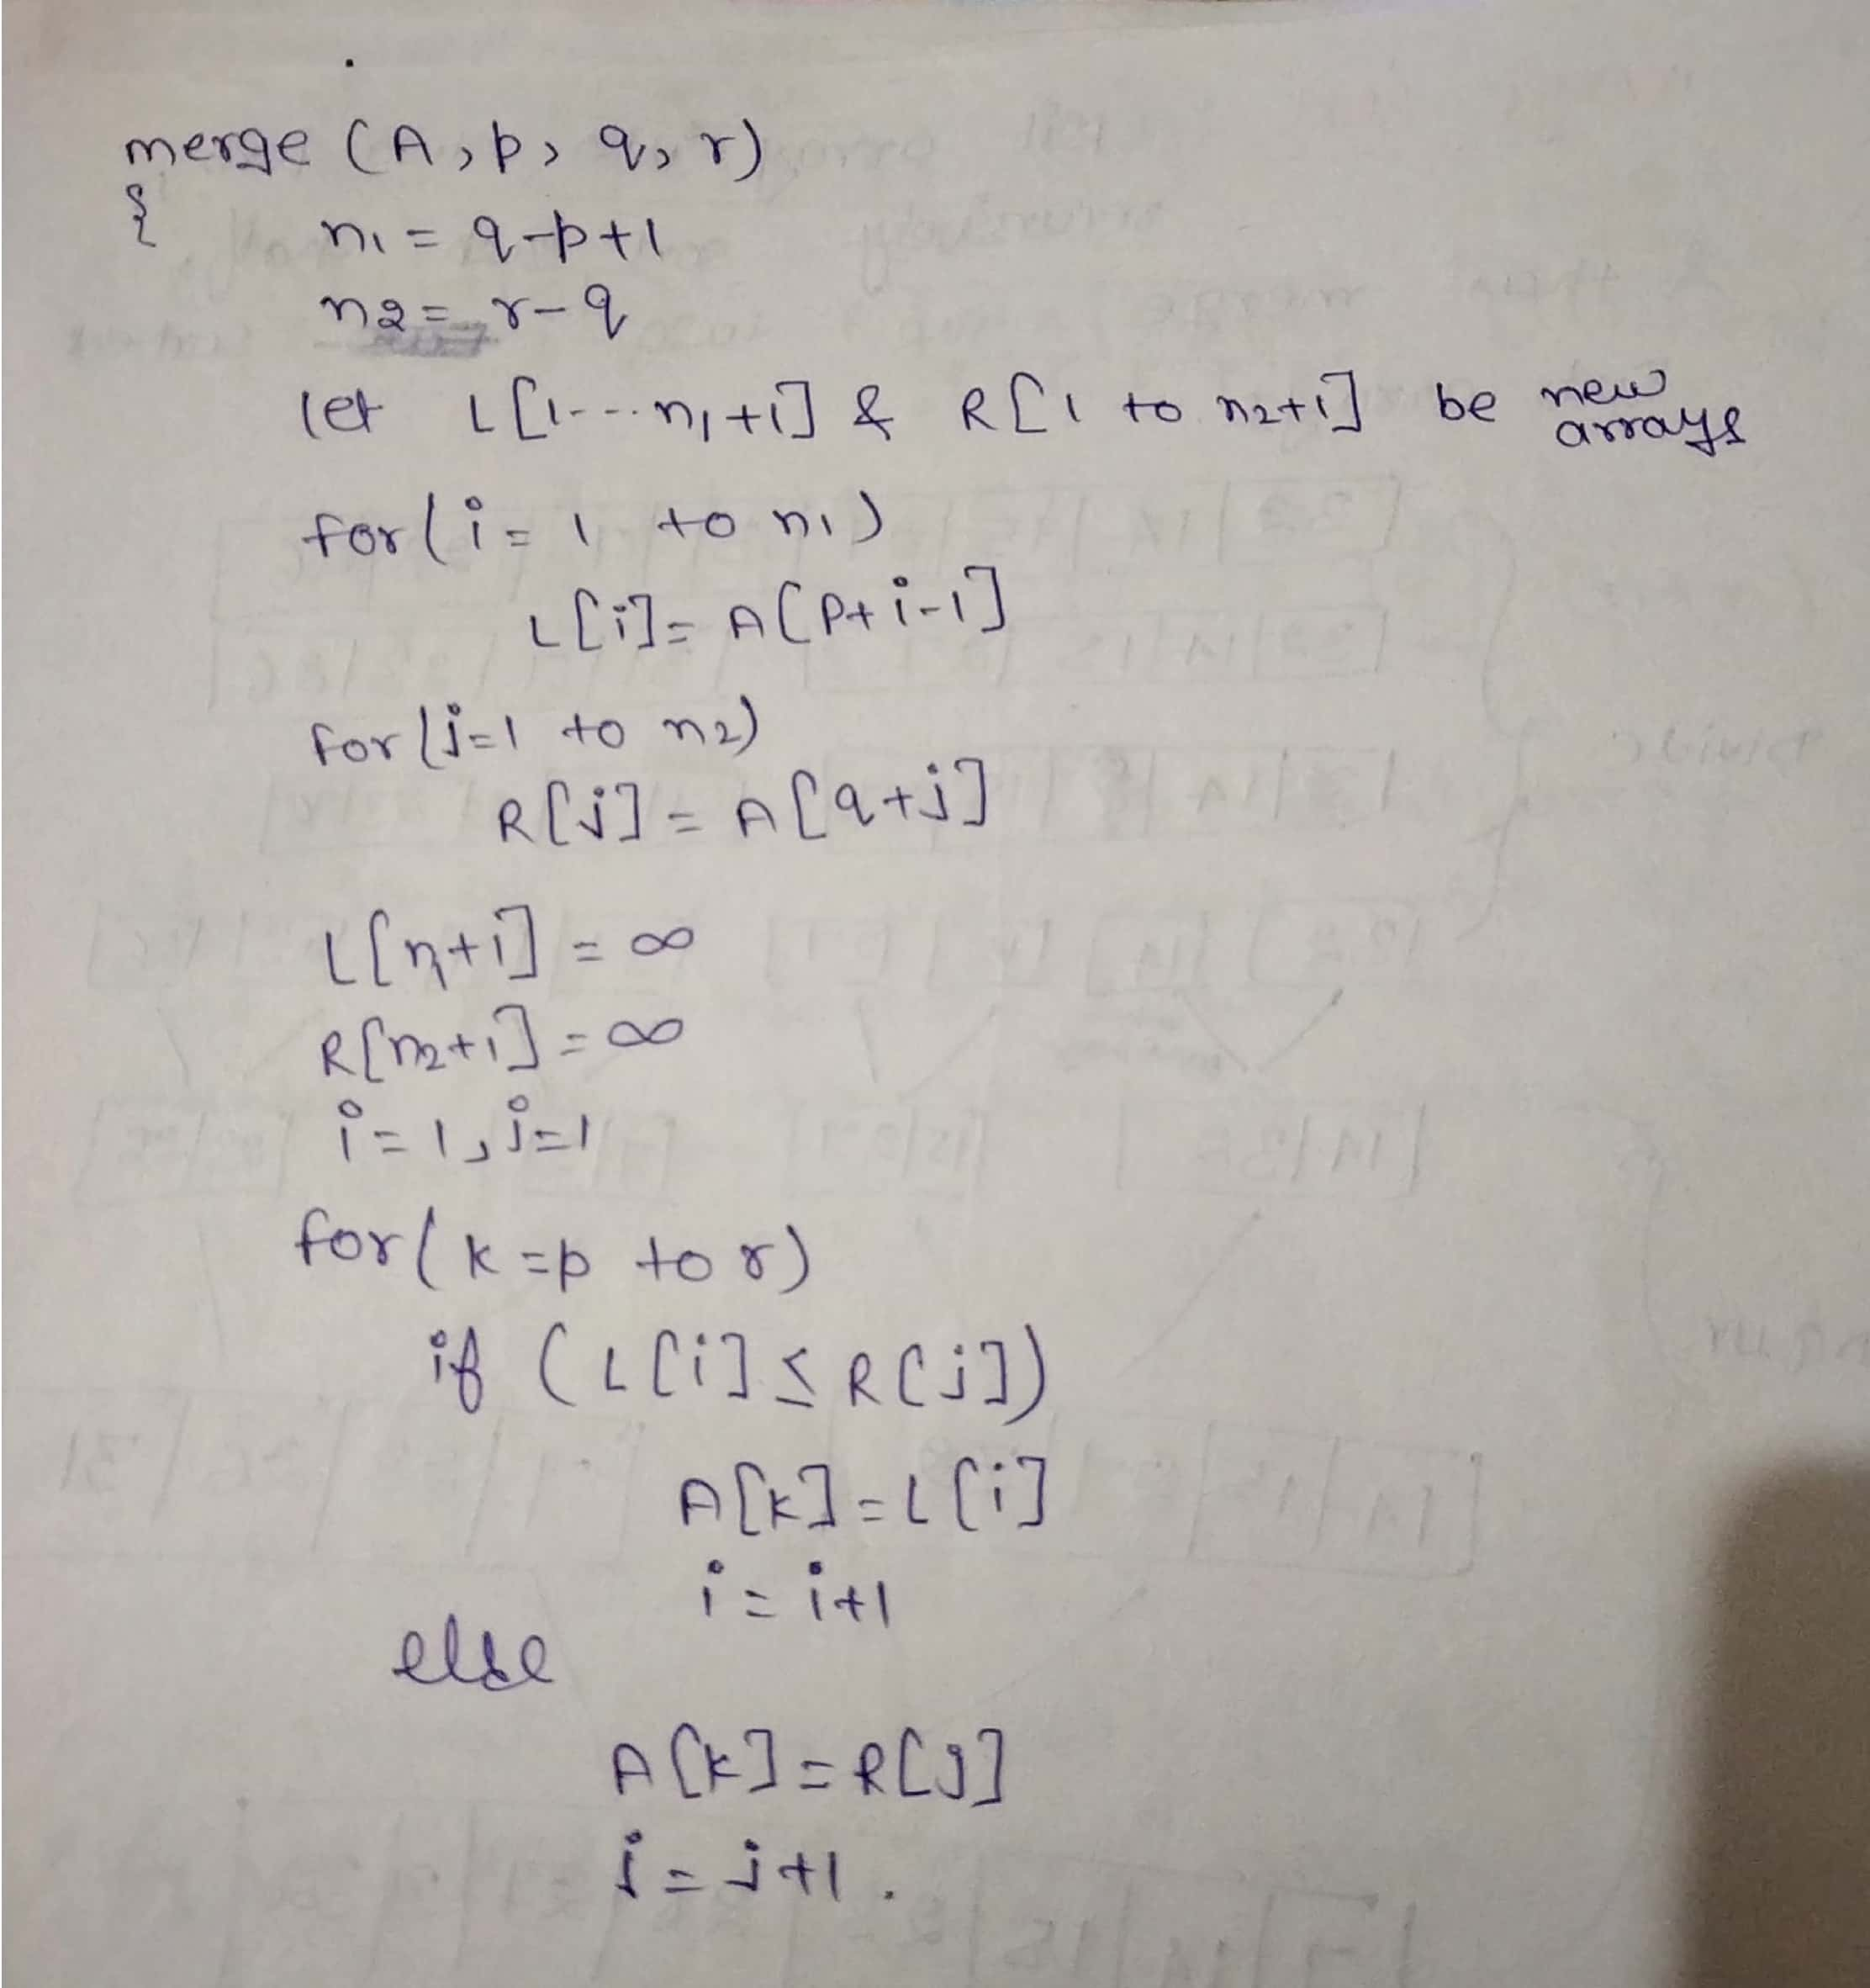

Slide 29
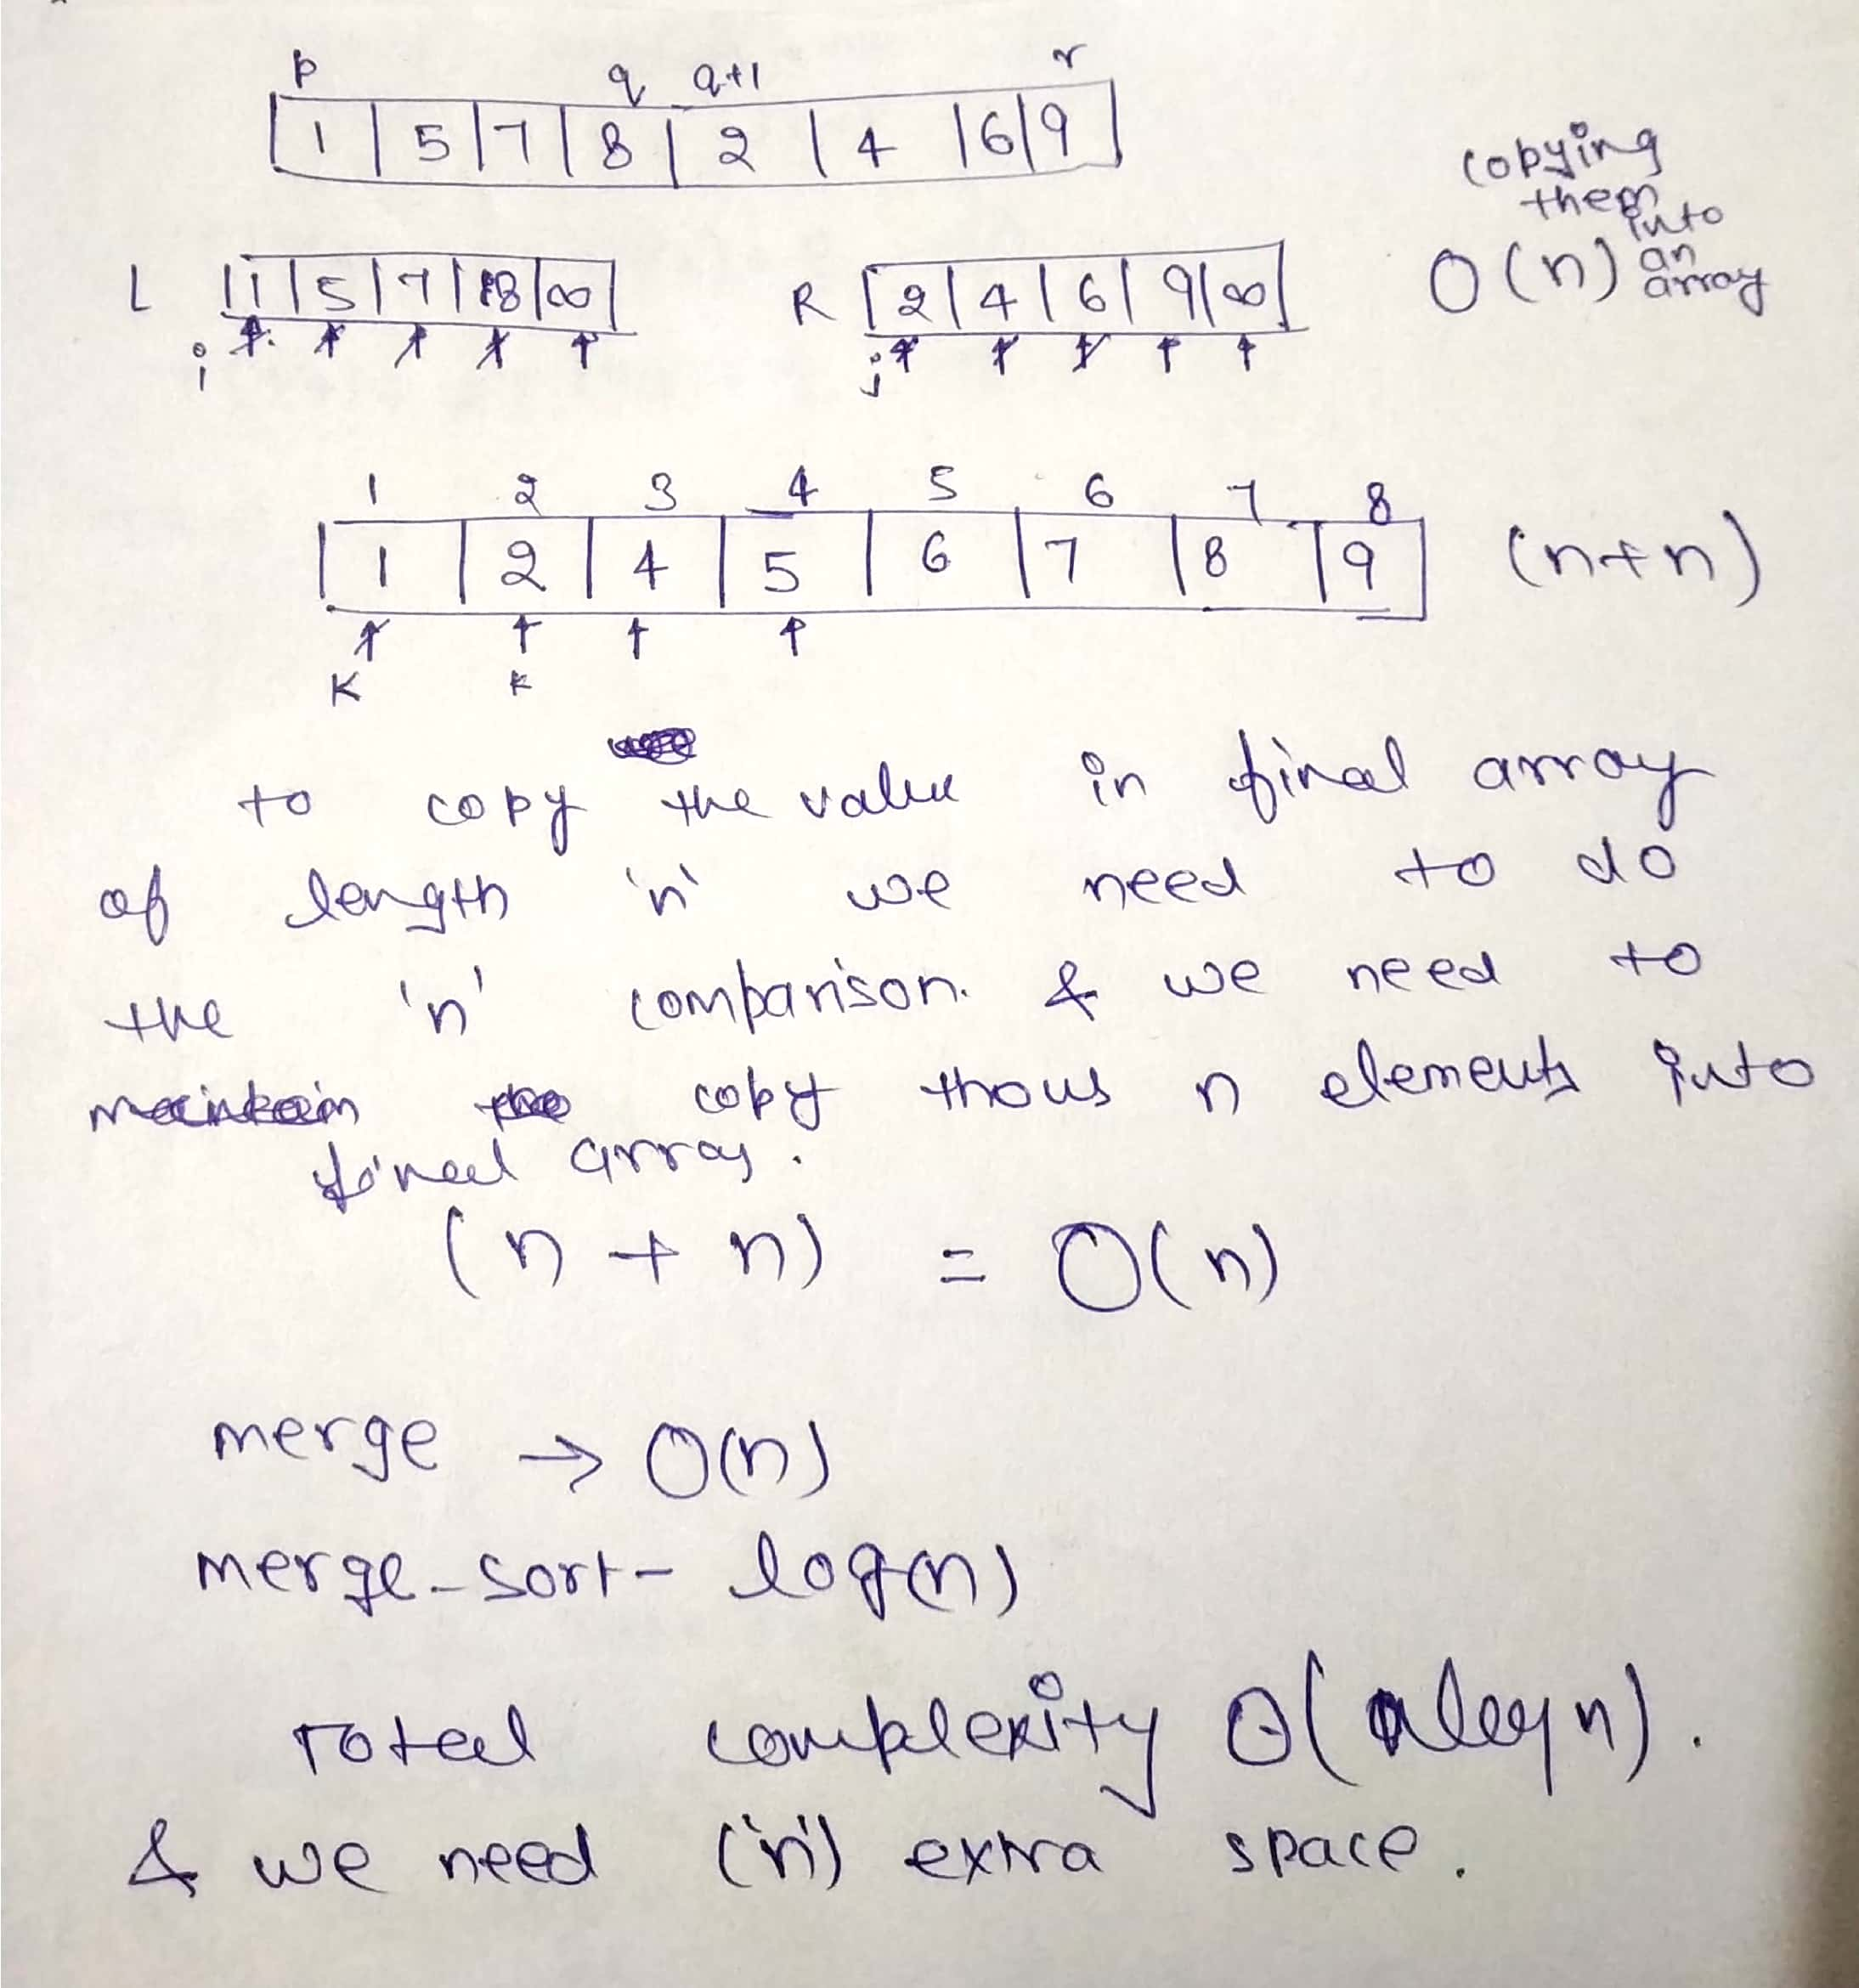

Slide 30
Analysis
Recurrence relation for merge sort is
T(n)=T(n/2)+T(n/2)+O(n)
T(n)=2T(n/2)+cn
Merge sort take O(nlogn) time in all the cases and O(n) space.

Slide 31
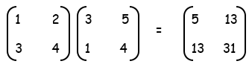
Strassen’s Matrix Multiplication
How do we multiply two 2×2 matrices ?
How many multiplications and additions did we need?

Slide 32
Strassen’s Matrix Multiplication
8 multis and 4 adds
Strassen in 1969 found out, he can do the above multiplication in the following way:
How many multiplications and additions did we need?
7 mults18 adds/subs
m₁+m₄-m₅+m₇ m₃+m₅
m₂+m₄ m₁+m₃-m₂+m₆
a₀₀ a₀₁
a₁₀ a₁₁
b₀₀ b₀₁
b₁₀ b₁₁
c₀₀ c₀₁
c₁₀ c₁₁
=
=
m₁ = (a₀₀+a₁₁)*(b₀₀+b₁₁)
m₅ = (a₀₀+a₀₁)*b₁₁
m₂ = (a₁₀+a₁₁)*b₀₀
m₆ = (a₁₀-a₀₀)*(b₀₀+b₀₁)
m₃ = a₀₀*(b₀₁-b₁₁)
m₇ = (a₀₁-a₁₁)*(b₁₀+b₁₁)
m₄ = a₁₁*(b₁₀-b₀₀)

Slide 33
Strassen’s Matrix Multiplication
Let us see how we can apply Strassen’s idea for multiplying two n×n matrices
Let A and B be two n×n matrices where n is a power of 2
Each block is (n/2)×(n/2)
We can treat blocks as if they were numbers to get the C = A*B
A₀₀ A₀₁
A₁₀ A₁₁
B₀₀ B₀₁
B₁₀ B₁₁
C₀₀ C₀₁
C₁₀ C₁₁
=

Slide 34
Strassen’s Matrix Multiplication
ALGORITHM Strassen(A, B, n)
//Input: A and B are n×n matrices
//where n is a power of two
//Output: C = A*B
if n = 1
return C = A*B
else
Partition A = and B =
where the blocks A_{ij} and B_{ij} are (n/2)-by-(n/2)
M1 <- Strassen(A₀₀+A₁₁, B₀₀+B₁₁, n/2)
M2 <- Strassen(A₁₀+A₁₁, B₀₀, n/2)
M3 <- Strassen(A₀₀, B₀₁-B₁₁, n/2)
M4 <- Strassen(A₁₁, B₁₀-B₀₀, n/2)
M5 <- Strassen(A₀₀+A₀₁, B₁₁, n/2)
M6 <- Strassen(A₁₀-A₀₀, B₀₀+B₀₁, n/2)
M7 <- Strassen(A₀₁-A₁₁, B₁₀+B₁₁, n/2)
C₀₀ <- M1+M4-M5+M7
C₀₁ <- M3+M5
C₁₀ <- M2+M4
C₁₁ <- M1+M3-M2+M6
return C =
Recurrence for # of multiplications is
M(n) = 7M(n/2) for n > 1
M(1) = ?
For n = 2^{m},
M(n) = 7M(n/2) = 7²M(n/2²)
A₀₀ A₀₁
A₁₀ A₁₁
B₀₀ B₀₁
B₁₀ B₁₁
M(n) = 7^{m} M(n/2^{m})
= 7^{m} = 7^{lgn}
= n^{lg7} ≈ n^{2.807}
For # of adds/subs,
A(n) = 7A(n/2)+18(n/2)² for n > 1
A(1) = 0
Using Master th^{m},
A(n) є Θ(n^{lg7}) better
than brute-force’s Θ(n³)
C₀₀ C₀₁
C₁₀ C₁₁

Slide 35
Powering a number
Problem: Compute a^{n} , where n ϵ N.
Naive algorithm: Ѳ(n).

Slide 36
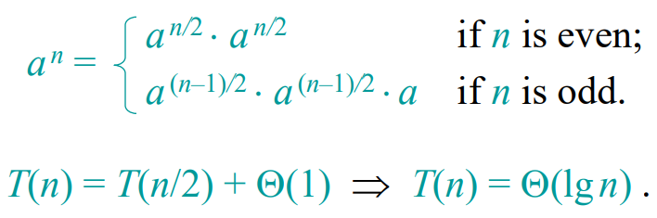
Powering a number
Divide-and-conquer algorithm:

Slide 37
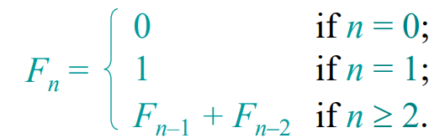
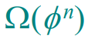
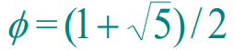
Fibonacci numbers
Recursive definition:
Naive recursive algorithm:
(exponential time), where is the golden ratio.

Slide 38
Maximum-subarray problem
Input: an array A[1..n] of n numbers
Assume that some of the numbers are negative, because this problem is trivial when all numbers are nonnegative
Output: a nonempty subarray A[i..j] having the largest sum S[i, j] = a_{i} + a_{i+1} +... + a_{j}
1 2 3 4 5 6 7 8 9 10 11 12 13 14 15 16
A
13 | -3 | -25 | 20 | -3 | -16 | -23 | 18 | 20 | -7 | 12 | -5 | -22 | 15 | -4 | 7

Slide 39
1 2 3 4 5 6 7 8 9 10 11 12 13 14 15 16
A
13 | -3 | -25 | 20 | -3 | -16 | -23 | 18 | 20 | -7 | 12 | -5 | -22 | 15 | -4 | 7
maximum subarray

Slide 40
A brute-force solution
Examine all possible S[i, j]
Two implementations:
compute each S[i, j] in O(n) time ⇒ O(n³) time
compute each S[i, j+1] from S[i, j] in O(1) time
(S[i, i] = A[i] and S[i, j+1] = S[i, j] + A[j+1])
⇒ O(n²) time
Ex: i 1 2 3 4 5 6
A[i] 13 -3 -25 20 -3 -16
S[2, 2] = -3
S[2, 3] = -28
S[2, 4] = -8
S[2, 5] = -11

Slide 41
A divide-and-conquer solution
1) Divide the given array in two halves 2) Return the maximum of following three a) Maximum subarray sum in left half (Make a recursive call)
b) Maximum subarray sum in right half (Make a recursive call) c) Maximum subarray sum such that the subarray crosses the midpoint

Slide 42
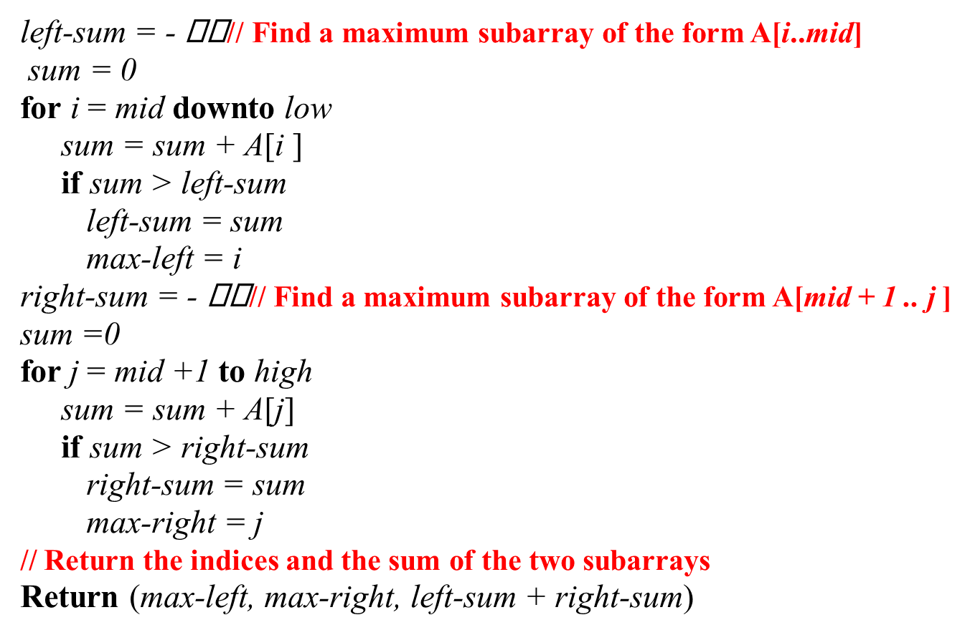
FIND-MAX-CROSSING-SUBARRAY (A, low, mid, high)

Slide 43
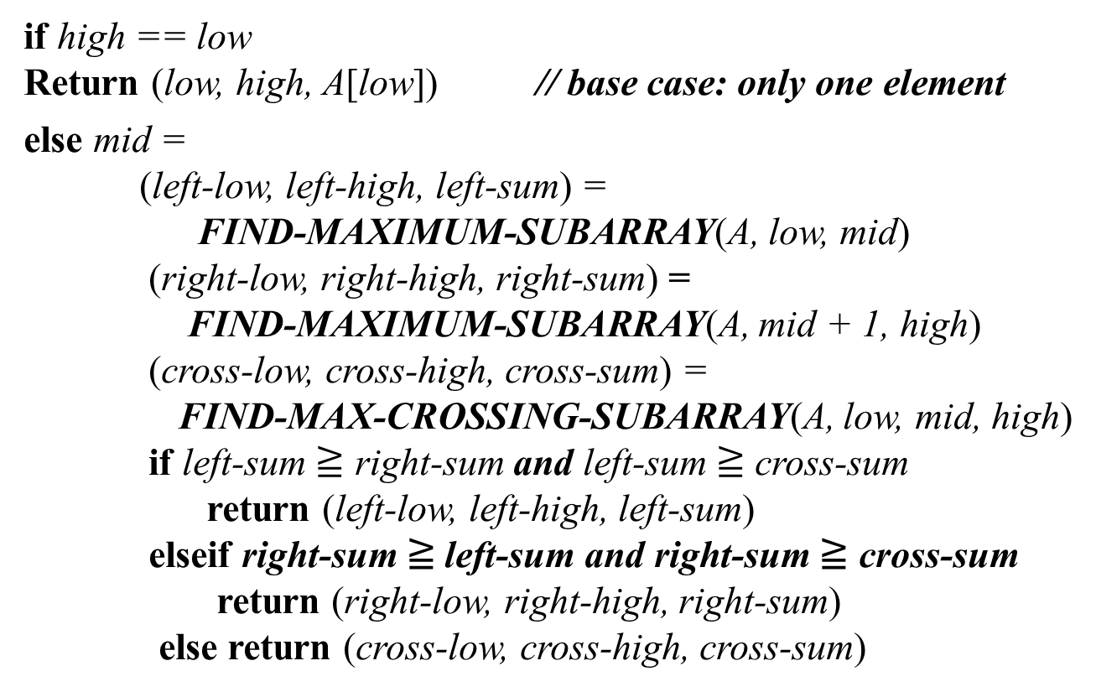
FIND-MAXIMUM-SUBARRAY (A, low, high)

Slide 44
Analyzing time complexity
FIND-MAX-CROSSING-SUBARRAY : Θ(n),
where n = high − low + 1
FIND-MAXIMUM-SUBARRAY
T(n) = 2T(n/2) + Θ(n) (with T(1) = Θ(1))
= Θ(nlg n)

